Slide 1





PROJECT BASED LEARNING-1 Group-1 Project-12

Slide 2

Machine Learning
Machine Learning

Slide 3
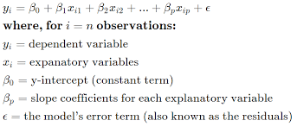
Topic
Multi Linear Regression :
Multiple Linear Regression is one of the important regression algorithms
which models the linear relationship between a single dependent continuous variable and
more than one independent variable.

Slide 4

STEPS
Import the Packages
Loading the Dataset
Data Preprocessing
Train and Test Data Split
Modelling
Predicting
Data Visualizing

Slide 5
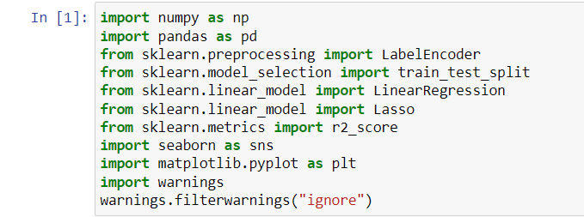
Import the Pakages

Slide 6
Load the Dataset
There are 5 different functions to load the dataset. They
are:
1. Manual Function
2. loadtxt Function
3. genfromtxt Function
4. read_csv Function
5. Pickle
I have used read_csv function to load the data.

Slide 7

Required :
Packages
NumPy
Pandas
Sklearn
Matplotlib
Softwares
Python
Jupyter Notebook

Slide 8









Data Preprocessing
df.head()
df.info()
df.describe()
df.isnull().sum()
df.corr()

Slide 9
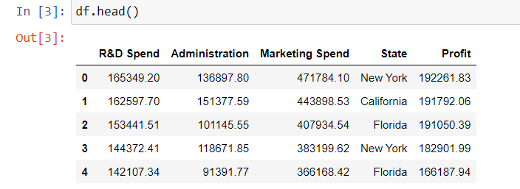
df.head( )
This function returns the first 5 rows of the dataframe. To override the default, you may insert a value between the parenthesis to change the number of rows returned.
Example: df.head(2) → this prints the first 2 rows of the dataframe

Slide 10
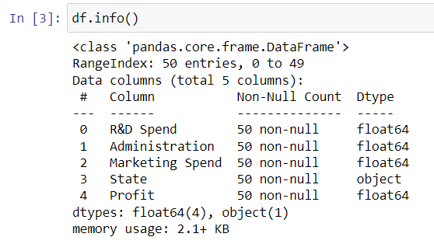
df.info( )
This function is used to print a concise summary of a DataFrame. This method prints information about a DataFrame including the index dtype and column dtypes, non-null values and memory usage.

Slide 11
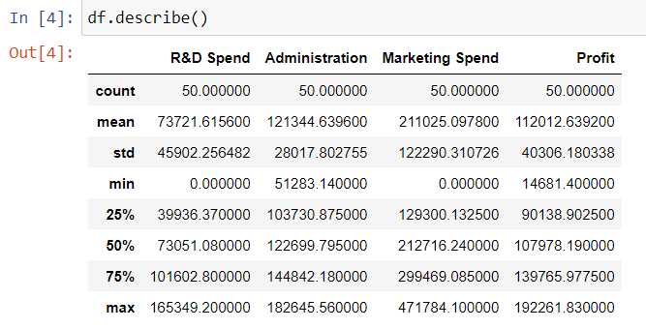
df.describe( )
This function is used for calculating some statistical data like percentile, mean and std of the numerical values of the Series or DataFrame. It analyzes both numeric and object series and also the DataFrame column sets of mixed data types.

Slide 12
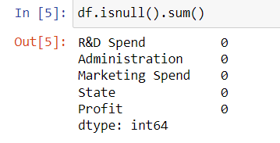
df.isnull( ).sum( )
This function returns the number of missing values in the data set. A simple way to deal with data containing missing values is to skip rows with missing values in the dataset.

Slide 13
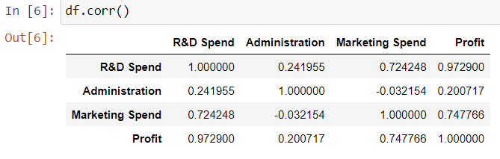
df.corr( )
This function is used to find the pairwise correlation of all columns in the dataframe. Any na values are automatically excluded. For any non-numeric data type columns in the dataframe it is ignored.

Slide 14
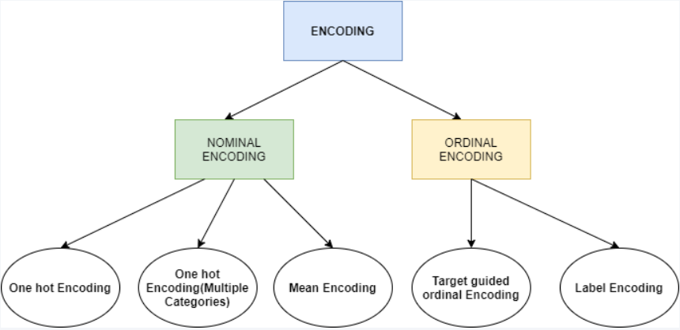
Encoding the data
Encoding is a technique of converting categorical variables into numerical values so that it could be easily fitted to a machine learning model. We have different types of encoding techniques. We mainly use 2 types of encoding techniques. They are
1. Label Encoder
2. One-Hot Encoder

Slide 15
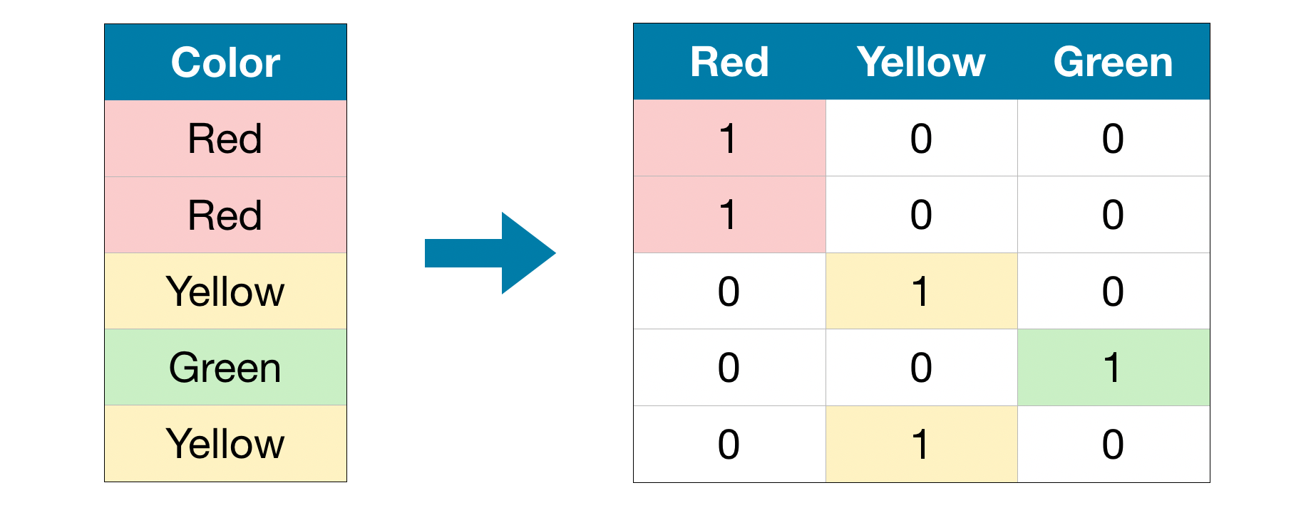
One-hot Encoder
One hot encoding is one method of converting data to prepare it for an algorithm and get a better prediction. With one-hot, we convert each categorical value into a new categorical column and assign a binary value of 1 or 0 to those columns. Each integer value is represented as a binary vector. All the values are zero, and the index is marked with a 1.

Slide 16
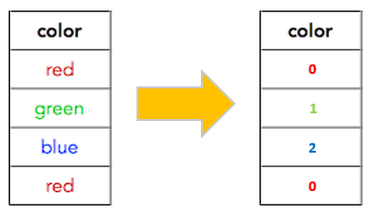
Label Encoder
Label Encoding is a popular encoding technique for handling categorical variables. In this technique, each label is assigned a unique integer based on alphabetical ordering.

Slide 17
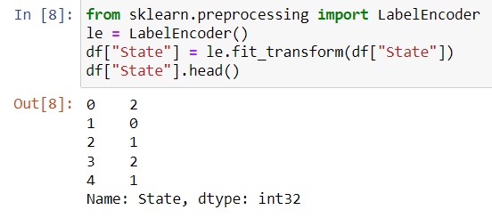
Label Encoder
We have used label Encoding technique in this Project to
convert the categorical data.

Slide 18
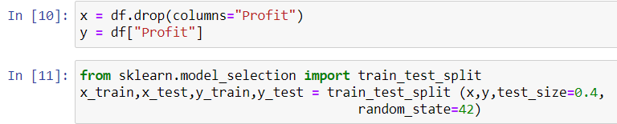
Train and Test the data
Train/Test is a method to measure the accuracy of your model. It is called Train/Test because you split the the data set into two sets: a training set and a testing set i.e 80% for training, and 20% for testing.

Slide 19
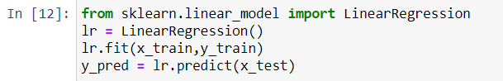
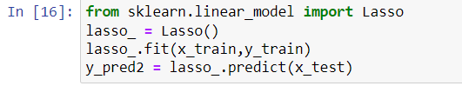
Modelling
Since our project is based on Multi Linear Regression we have to use 2 to 3
models to predict the accuracy. Here we have used Linear Regression model
and also Lasso model. We fit and predict the data into the model.

Slide 20
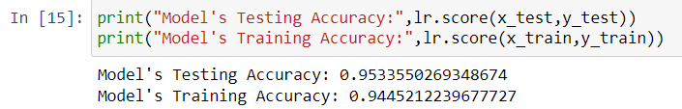
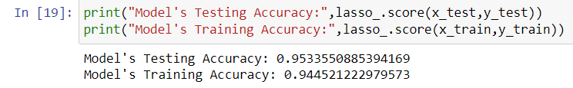
Predicting
“Prediction” refers to the output of an algorithm after it has been trained on a
historical dataset and applied to new data when forecasting the likelihood of a
particular outcome.

Slide 21
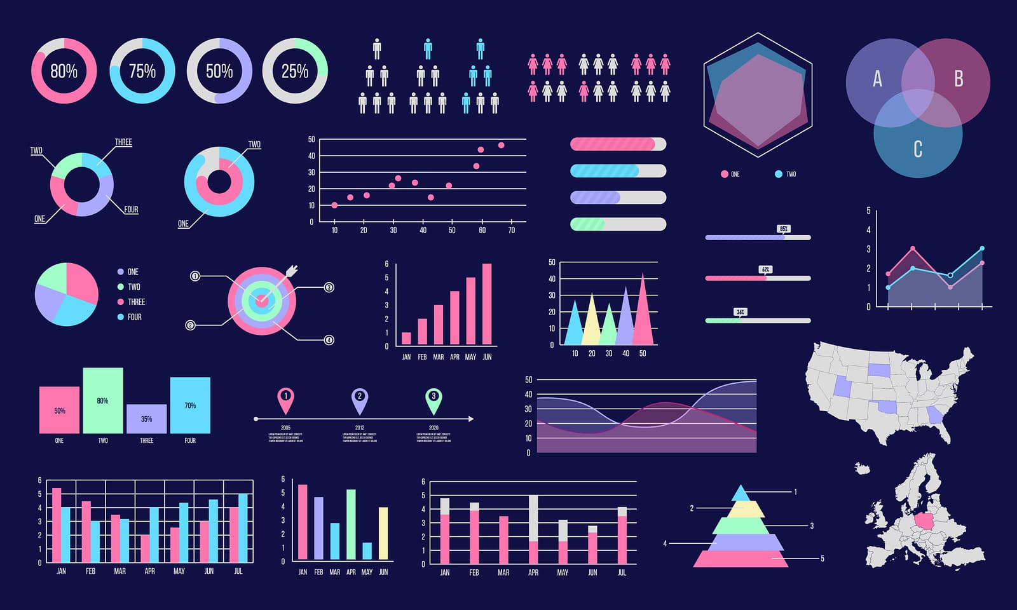
Data Visualization
Data visualization is defined as a graphical representation that contains the information and the data. By using visual elements like charts, graphs, and maps, data visualization techniques provide an accessible way to see and understand trends, outliers, and patterns in data. Data visualization libraries available in python are
1. Matplotlib
2. Plotly
3. ggplot
4. Seaborn
5. Altair
6. Geoplotlib
7. Bokeh

Slide 22
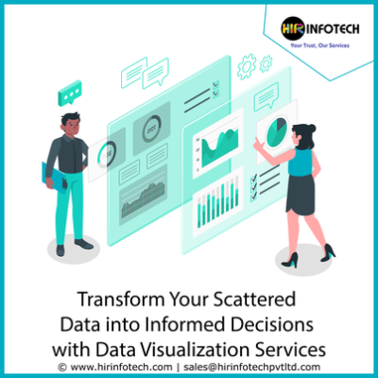
Types of Visualizations
1. Line Chart
2. Bar Chart
3. Pie Chart
4. Donut Chart
5. Histogram Plot 6. Density Plot
7. Scatter Plot
8. Box Plot
9. Correlation Matrix Plot
10. Scatter Matrix Plot
11. Distribution Plot
12. Violin Plot
13. Heat map

Slide 23
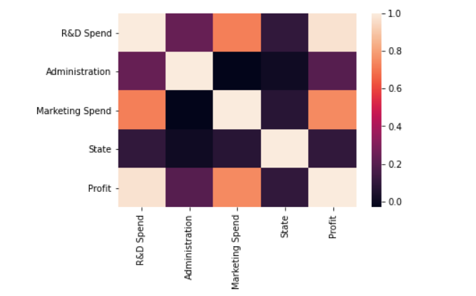
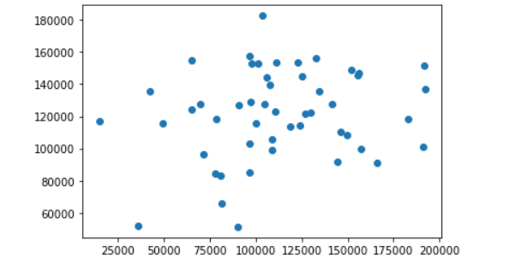
Heat map
Representation of data in the form of a map or diagram in which data values are represented as colours.
Scatter Plot
A graph in which the values of two variables are plotted along two axes, the pattern of the resulting points revealing any correlation present.

Slide 24
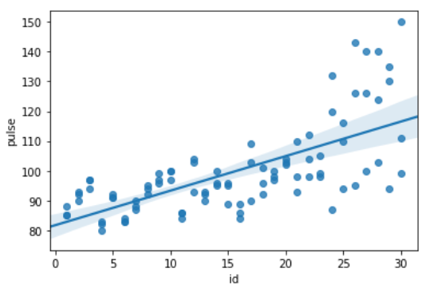
Reg Plot
This method is used to plot data and a linear regression model fit. Here we have used regplot in this Project.
Example Plot

Slide 25
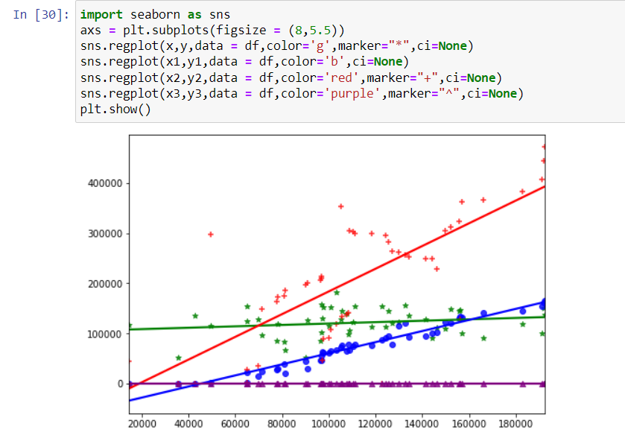
Reg Plot

Slide 26


Thank You!

